Slide 1
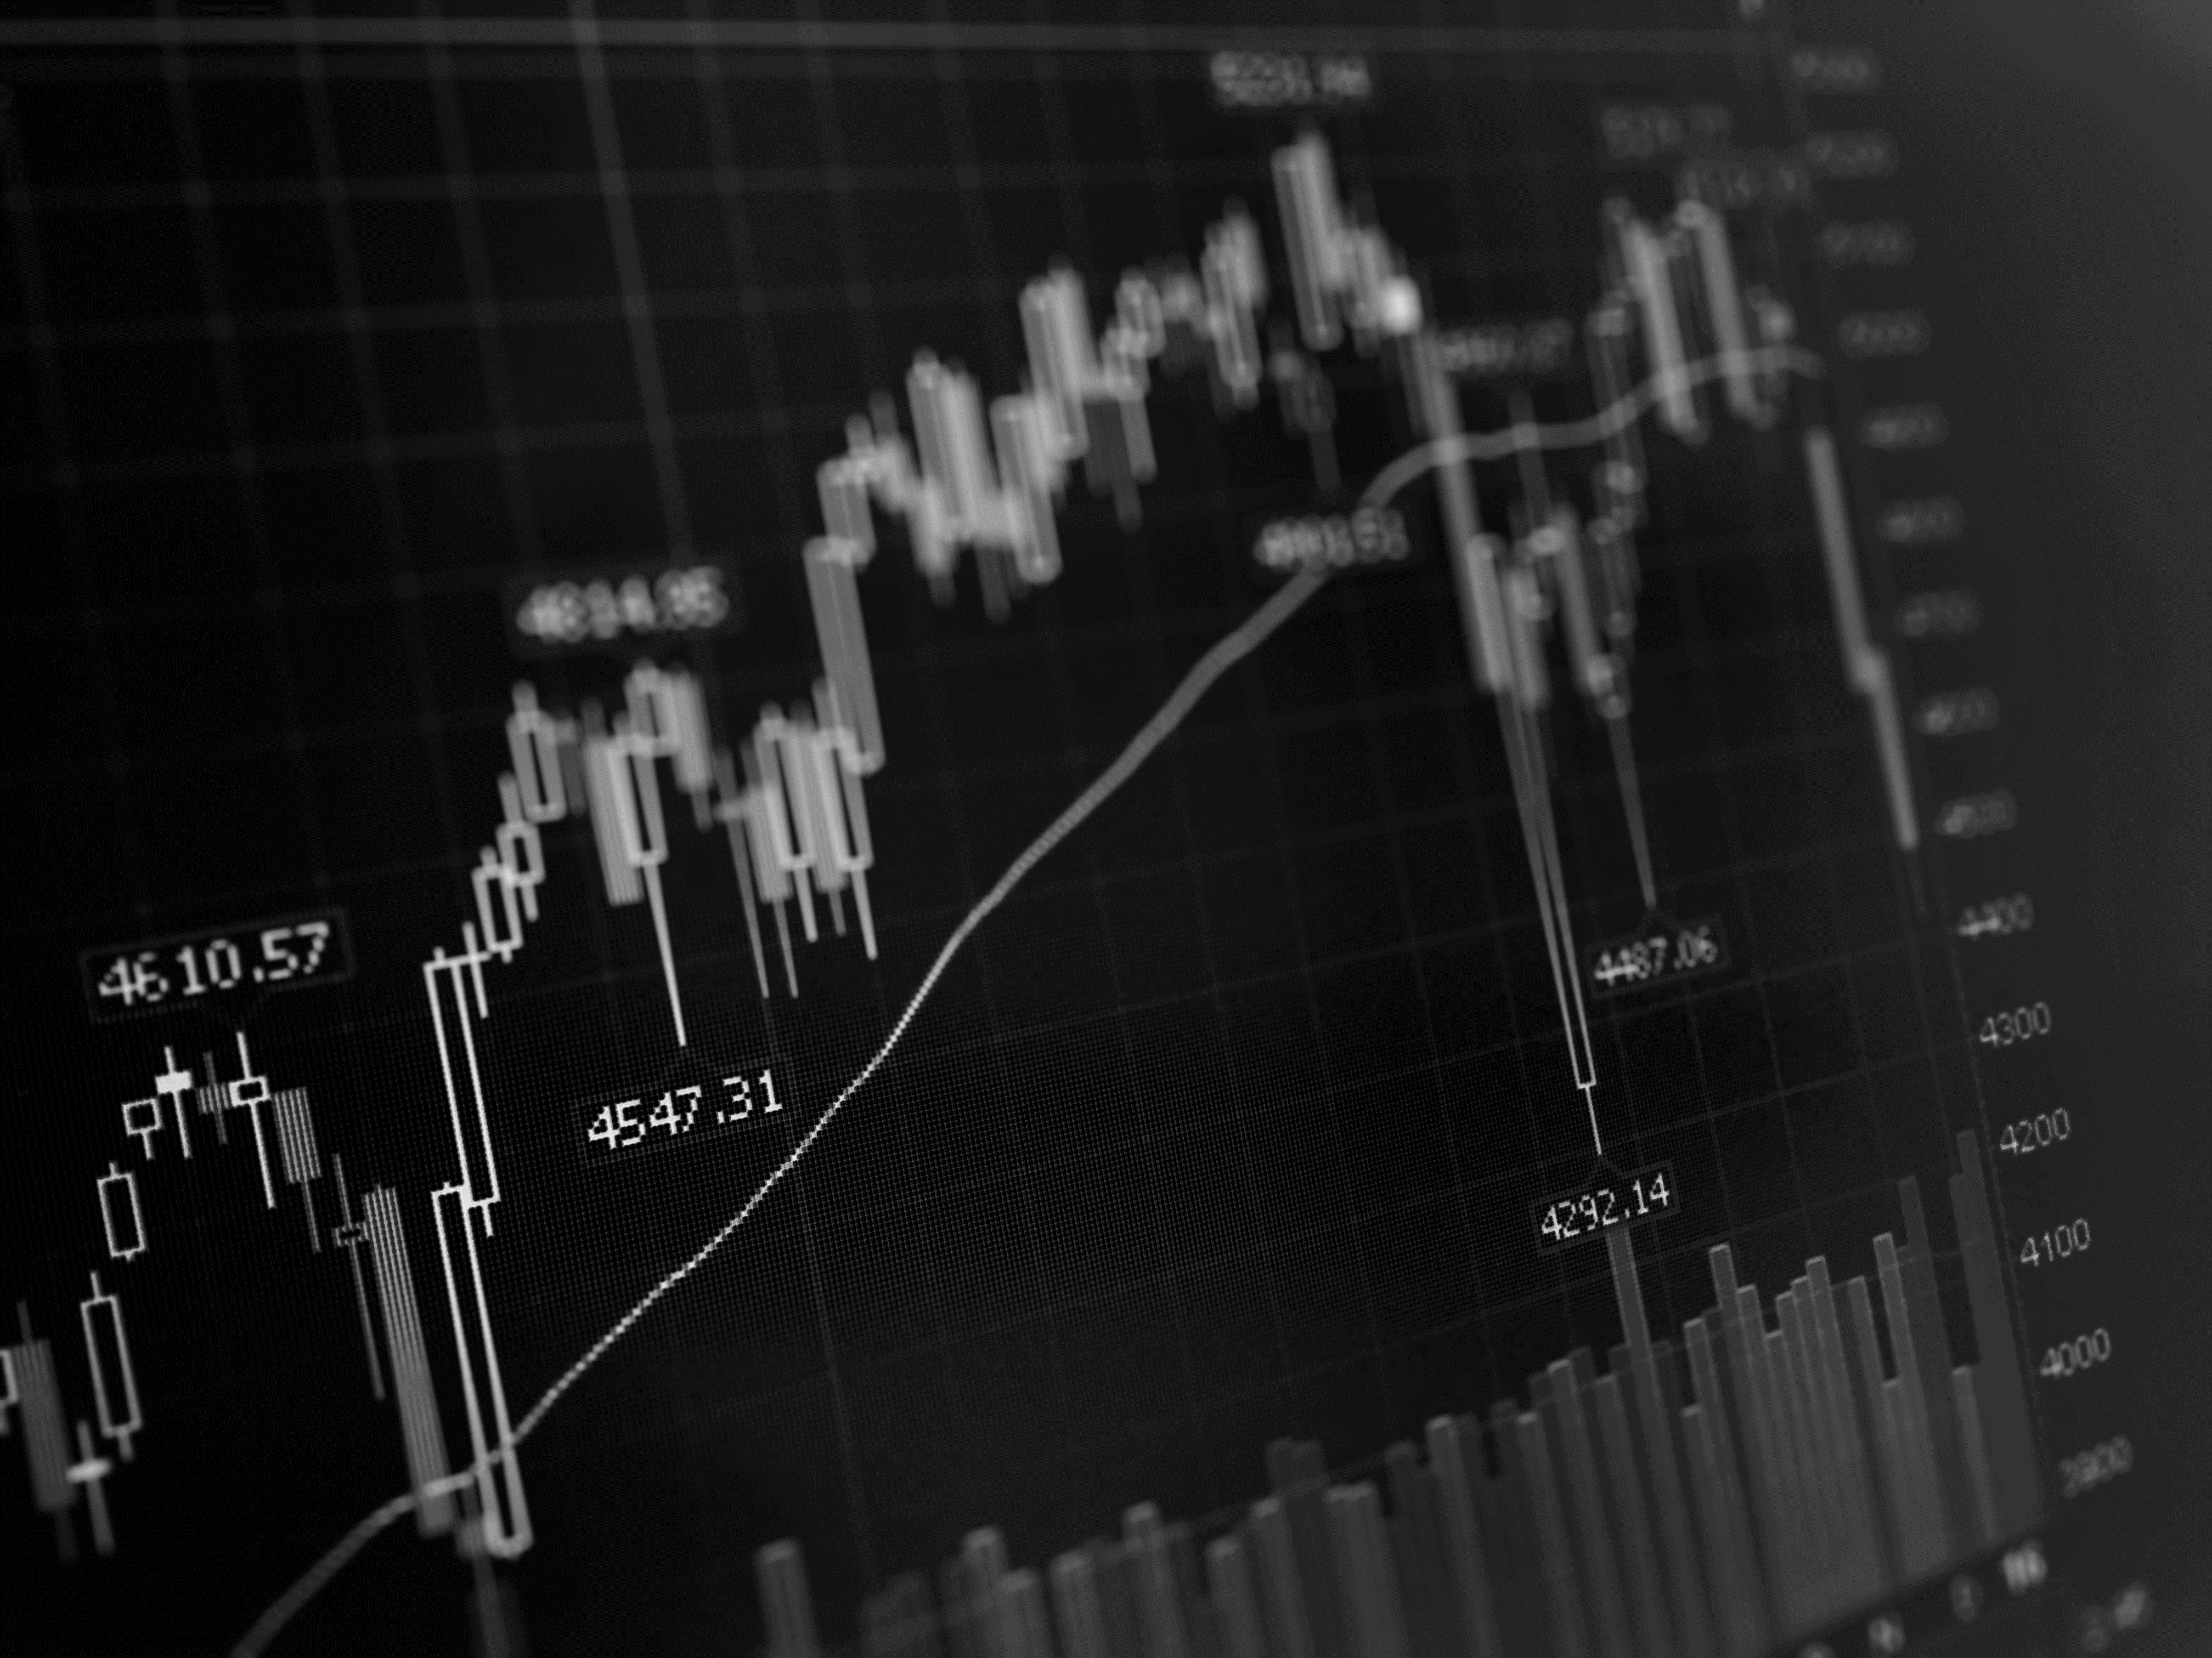

WHAT FACTORS PREDICT INFLATION?
WITH LINEAR REGRESSION MODELING
Trish Girmus | May 2, 2022
Notes:
Hello! My name is Trish Girmus, an aspiring future data scientist, and today I am going to discuss a topic that is on everyone’s minds these days – inflation.

Slide 2
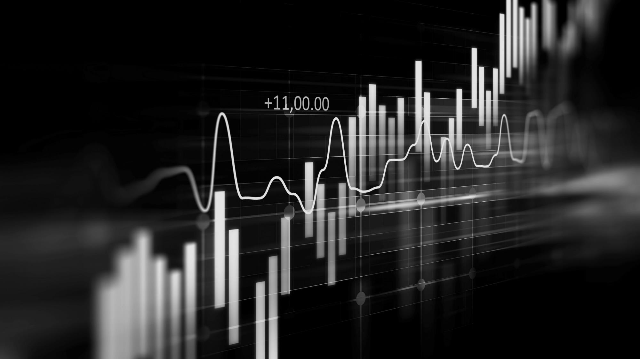
PROBLEM
FEBRUARY 2022
Consumer Price Index (CPI) reached 7.9% from February 2021
Highest % in U.S. since January 1982
INFLATION
Rising costs of good and services continues to increase
Why?
BUSINESS PROBLEM
Predict the features which attributed to the latest CPI measure
Linear Regression used for modeling
Notes:
In February 2022, the Consumer Price Index, also known as CPI, reached its highest percentage the United States has witnessed in 40 years! At a 7.9% increase from a year earlier, the concern of inflation with the rising costs of goods and services is affecting all consumers, one way or another. The purpose of this presentation is to provide an overview of inflation and CPI, and to predict the feature or features which attributed to the latest CPI measure increase. Linear regression modeling was used for prediction.

Slide 3
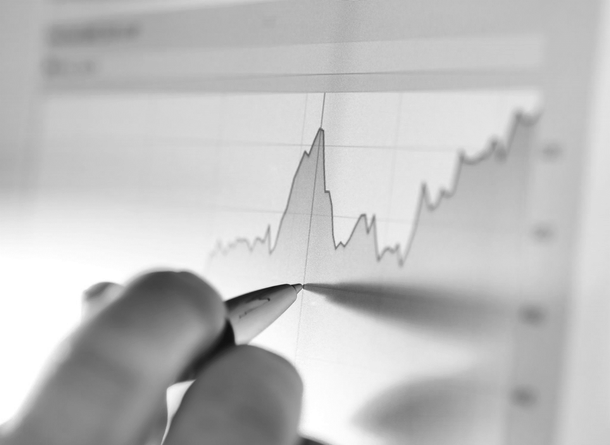
WHAT IS INFLATION?
A measure of rising prices in an economy for goods & services
Examples :
Housing
Food
Electricity
Gasoline
Transportation
Industrial Goods
Notes:
You might ask, so what exactly is inflation? According to Investopedia, “inflation is a measure of rising prices of goods and services in an economy”. Examples of these goods and services include housing, food, electricity, gasoline, transportation, and industrial goods. Typically, this measure occurs over a year and looks at the average rise in prices. Over time, the purchasing power of a dollar decreases and therefore costs more to buy goods and services. When a CPI measure increases, so does the cost of everything else. A lower CPI measure means a lower cost in goods and services.

Slide 4
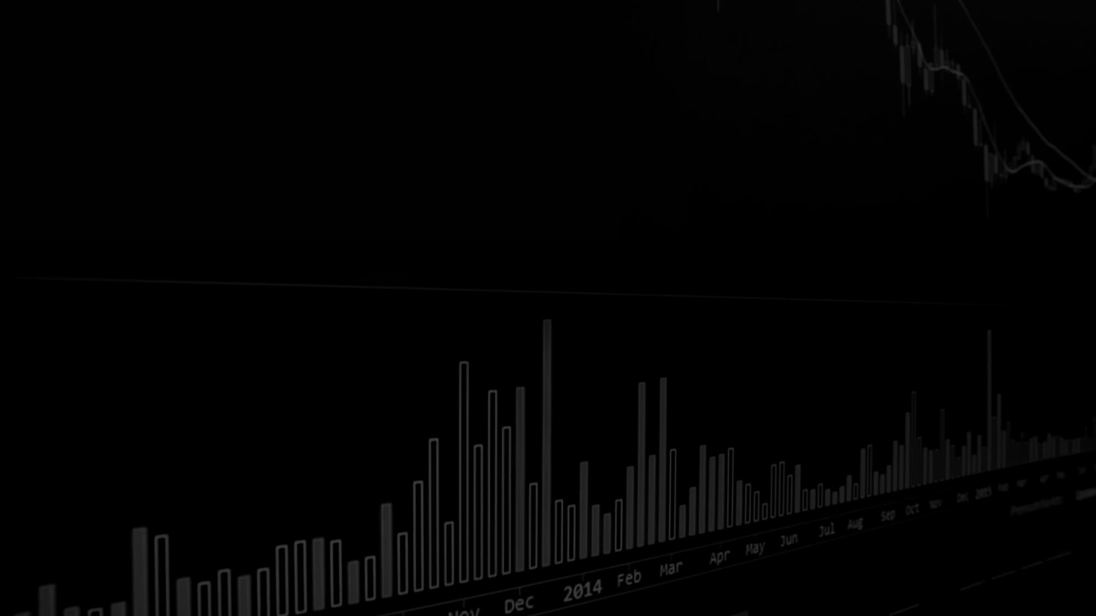
POWER OF DOLLAR COMPARISON
$5
→
$22.05
=
341.0%
1978
2022
Cumulative Rate of Inflation
Notes:
Here is an example of what inflation looks like with the power of a dollar. As you see here, in 1978 if the cost of an item was $5, now in 2022, to purchase that same item it would cost $22.05! This is a 341.0% cumulative rate of inflation.

Slide 5
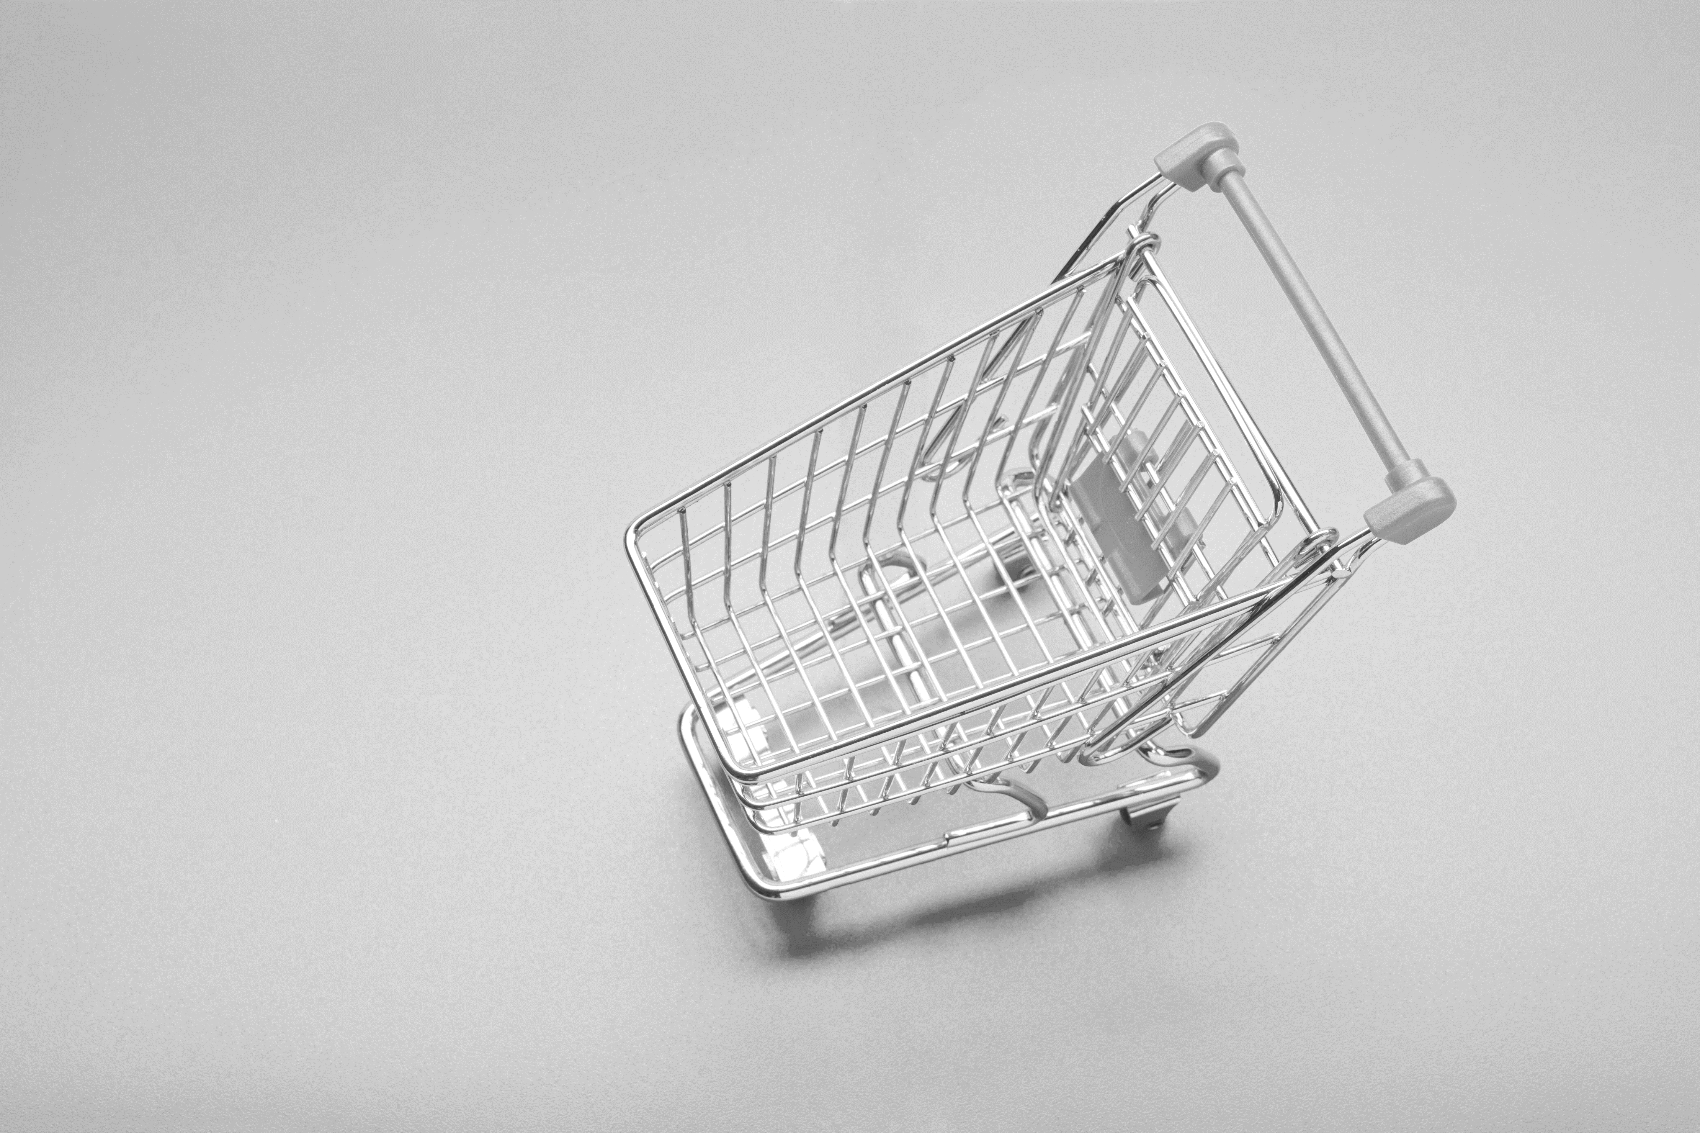
WHAT IS CPI?
Definition
A measure of the average change over time in prices paid for a market basket of consumer goods and services
8 Categories measure cpi
Food & Beverage
Housing
Apparel
Education & Communication
Medical Care
Recreation
Transportation
Other Goods & Services
Notes:
There are two ways to measure inflation: the Consumer Price Index (CPI) and Producer Price Index (PPI). CPI measure was used for this project to identify inflation. CPI is defined by the U.S. Bureau of Labor Statistics as “a measure of the average change over time in the prices paid by urban consumers for a market basket of consumer goods and services”. PPI in contrast, reports a change in price which influences domestic producers.
Consumers receive household surveys from government agencies to determine the basket cost of frequently purchased items over a period of time. This is calculated by using a weighted average of the prices for those items. The basket price is then reported to the U.S. Bureau of Labor Statistics or BLS each month and identifies the current CPI measure. There are eight fundamental categories according to the BLS which measure CPI.
These include:
Food & Beverage
Housing
Apparel
Education & Communication
Medical Care
Recreation
Transportation
Other Goods & Services
There are a few factors which can attribute to increases in price: production costs, demand, and fiscal policy. However, over the past two years, anomalies such as current and world events are also contributing to inflation. These include: the COVID-19 pandemic and the war in Ukraine. Consumers have witnessed higher wages, low interest rates, high housing costs, and high demand with low supply, as a few examples. The analysis and modeling conducted provides more insight into this topic.

Slide 6
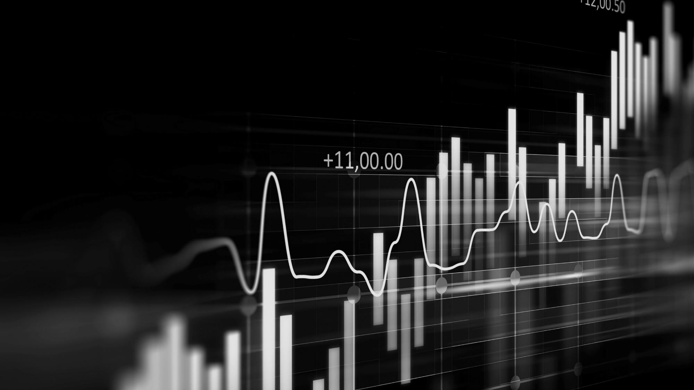
DATA EXPLANATION
DATA
dates
variables
- United States analysis only
- Secondary data collected
- Quantitative & Qualitative
Data used for project ranged from November 1978 to February 2022
15 variables selected for initial analysis & modeling
Notes:
Due to monetary currency, timelines in history with dates, events, laws, economic outlooks and other various factors, the United States was the only country selected for this project. Secondary data was used for this project from several sources, with the majority collected from the U.S. Bureau of Labor Statistics website. It contained 11 categories/variables. The time range selected was November 1978 to February 2022. This was due to missing data in earlier years of some categories. Additional data was collected, and four variables were added to the dataset. All data used for the project was both quantitative and qualitative. In total, 15 variables were initially selected for analysis and modeling.

Slide 7


VARIABLES
Name of Variable | [variable_name]
Year [year]
Month [month]
CPI [cpi]
Gasoline [gas]
Electricity [electricity]
Food [food]
Shelter [shelter]
Transportation [transportation]
Medical Care [medical_care]
Unemployment Rate [unemployment_rate]
Employment Population Ratio [employment_pop_ratio]
Presidential Political Party [pres_political_party]
Consumer Confidence Index [cci]
Crude Oil [crude_oil]
Cause [cause]
Notes:
The variable names are:
Year, month, CPI, Gasoline, Electricity, Food, shelter, Transportation, Medical care, Unemployment rate, employment population ratio, presidential political party, consumer confidence index, or CCI for short, crude oil, and cause.

Slide 8
METHODS
PYTHON
Data cleaning
Exploratory data analysis
- Programming Language used for project
(EDA)
Notes:
Python was the programming language used for analysis and modeling. As mentioned in the previous slide, the data initially contained 15 variables, and 520 rows of data. Most data were measured as an Index. To make all data the same measure, data not containing values as Indexes were standardized during the data cleaning process. This was calculated by dividing each value by the first data point, was which November, 1978 and multiplying by 100. This is the methodology used for calculating the CPI. The variable [cause] did not include specific data for events by month. A categorical event was added only to each January of the corresponding year and had missing values for February through December. Due to the complexity and research required to dummy encode and standardize this variable, it was dropped during data cleaning and not used for analysis or modeling.
For exploratory data analysis, Line charts were created using the matplotlib library in Python to visualize the relationships between the variables.

Slide 9
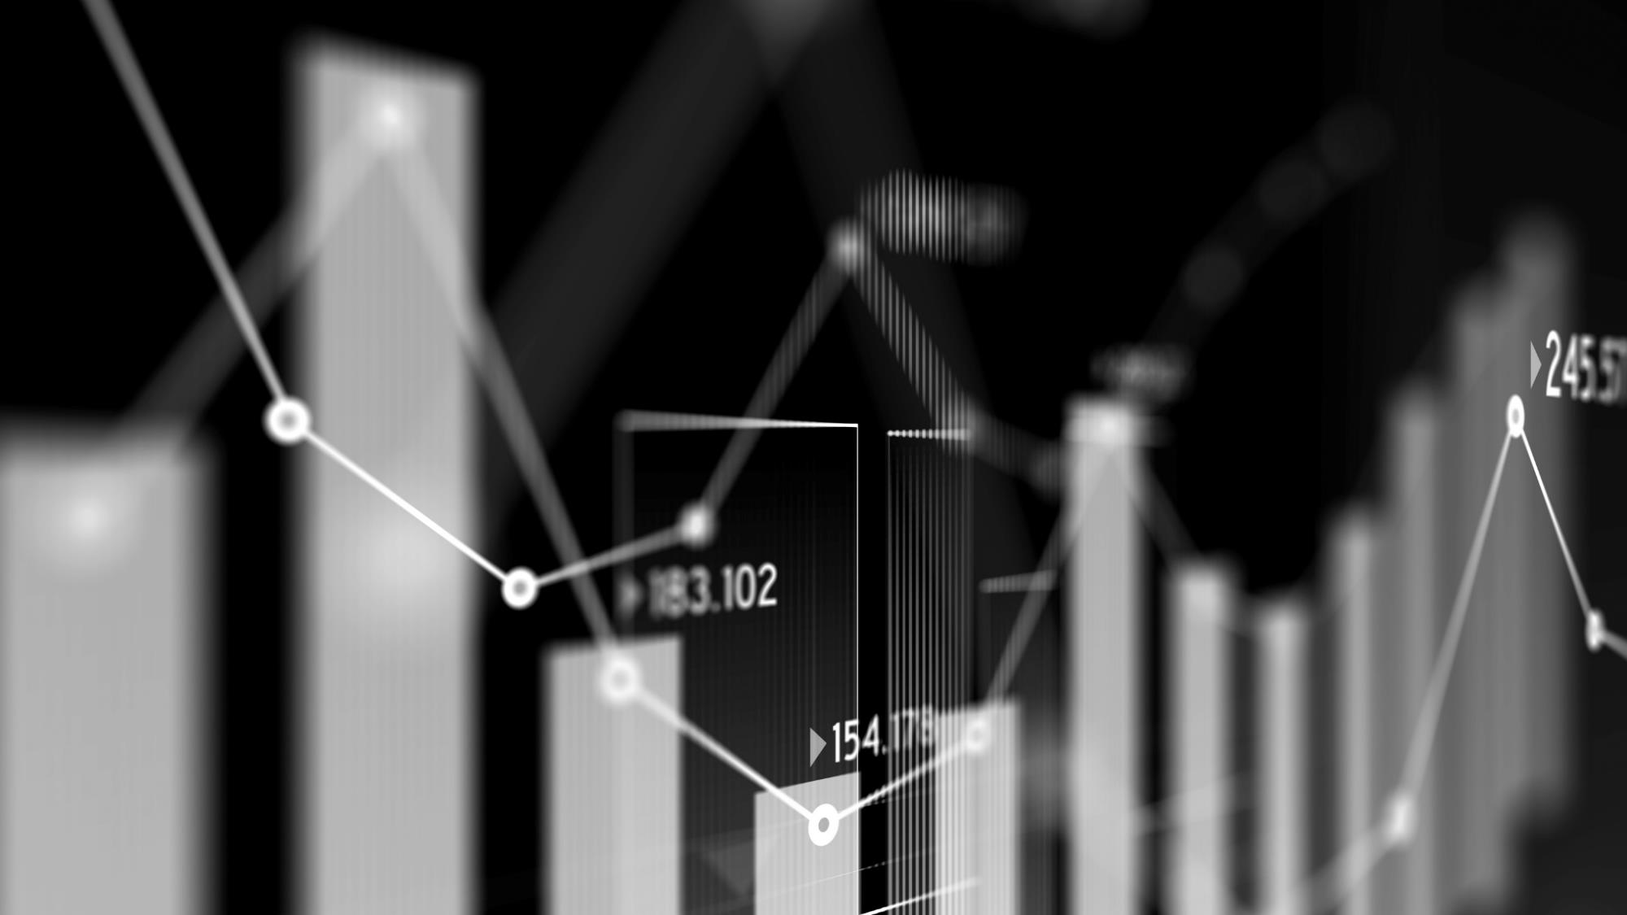
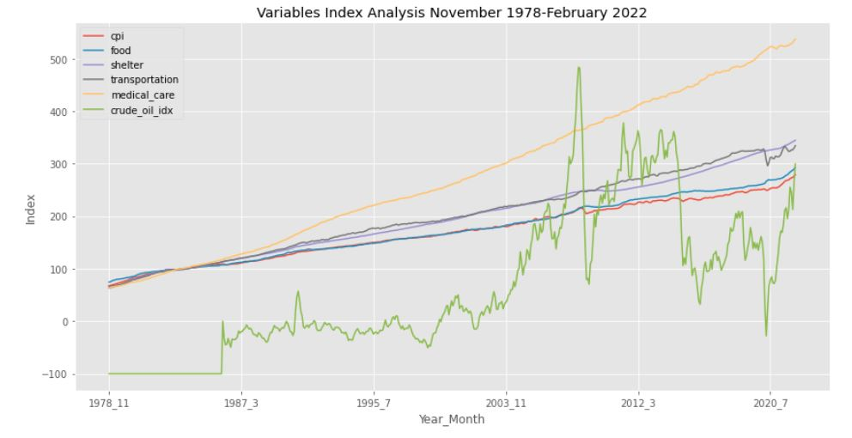
VISUALIZATIONS
COMPETITORS
Notes:
The first line chart created contained the variables [cpi], [food], [shelter], [transportation], [medical_ care], and [crude_oil_idx]. All variables minus [crude_oil_idx] showed a steady increase over 43 years with [medical_care] increasing the most. The [crude_oil_idx] indicates a spike around 2008, which signaled the financial crisis and start of the great recession. It dips again around mid-2020, during the pandemic.

Slide 10
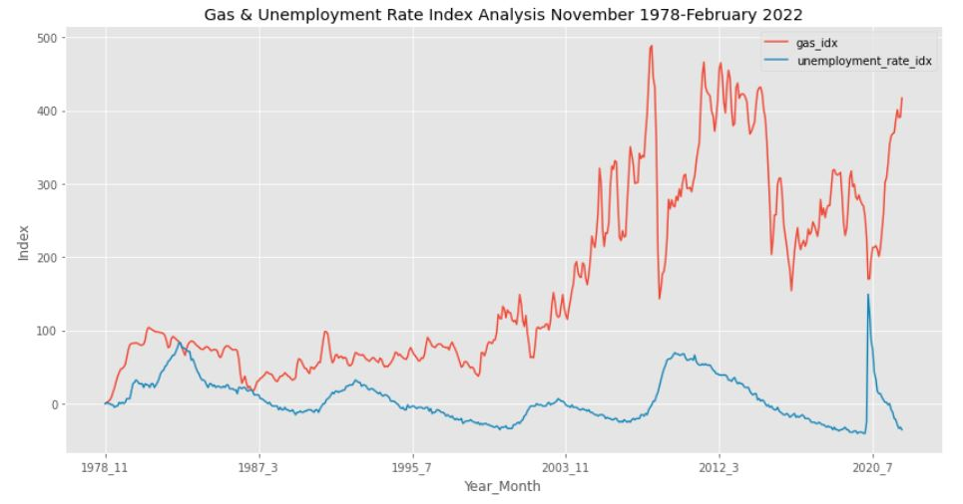
VISUALIZATIONS
COMPETITORS
Notes:
Subsequent line charts included relationships between the following variables over the same time span:
[gas_idx] and [unemployment_rate_idx]

Slide 11
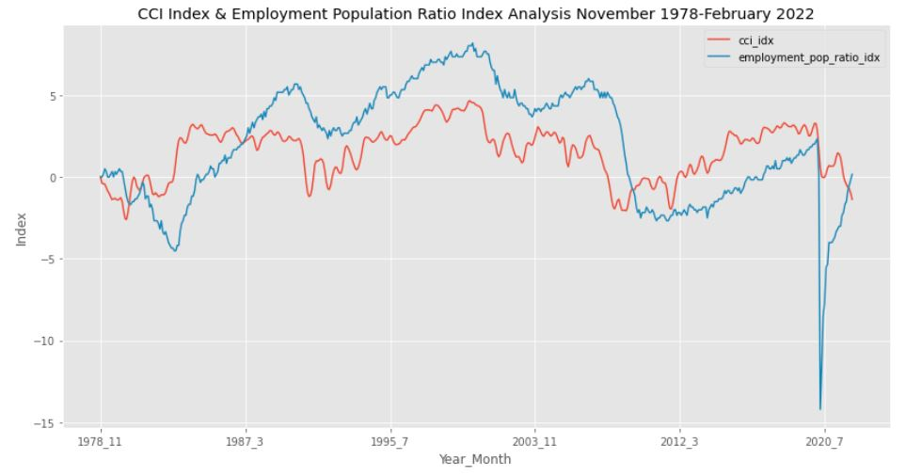
VISUALIZATIONS
COMPETITORS
Notes:
[cci_idx] and [employment_pop_ratio_idx]

Slide 12
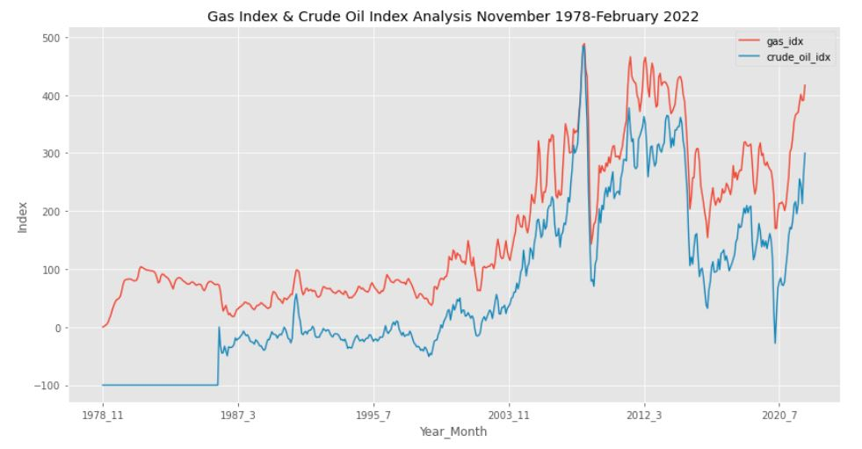
VISUALIZATIONS
COMPETITORS
Notes:
[gas_idx] and [crude_oil_idx]
As you see on each of these slides, the relationship patterns with the two pairs of variables were closely aligned. Sharp increases or decreases again signaled events in 2008, 2009, and 2020.

Slide 13
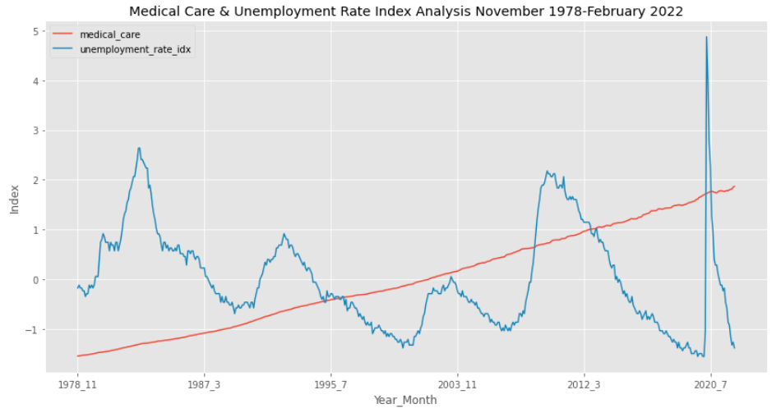
VISUALIZATIONS
COMPETITORS
Notes:
The variables [medical_care] & [unemployment_rate_idx], showed regardless of an increase or decrease of the unemployment rate index over time, medical care continues to increase.

Slide 14
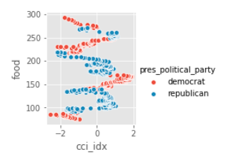
VISUALIZATIONS
Notes:
Here, the categorical variable [pres_political_party], is used. The variables [food] and [cci_idx] show that food values can be expected to be higher for a lower cci index. There is a wider range for Republicans. When Democrats are in office, the food index doesn’t change much during the presidential term, but the range changes a lot when Republicans are in office.

Slide 15
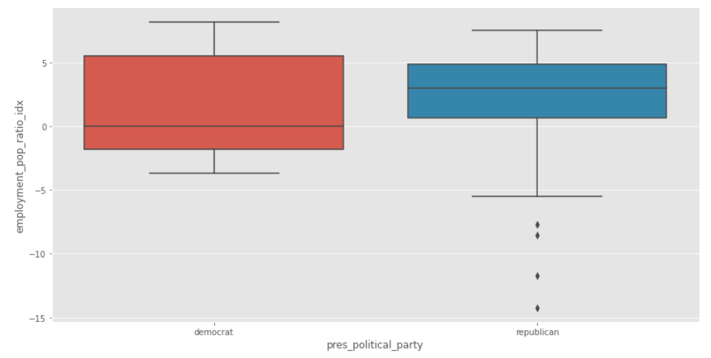
VISUALIZATIONS
Employment Population Ratio & Presidential Political Party
Notes:
The boxplot in this visualization shows the variables [employment_pop_ratio_idx] & [pres_political_party]. Here you will see that employment is greater when Democrats are in office. Outliers were present for the Republicans, which may be due to the COVID-19 pandemic.

Slide 16
ANALYSIS
MODELING
Dependent variable
Five models created
- Linear Regression
- Test size 0.40 & 0.30 used
- Test & train dataset created
- Ordinary Least Square (OLS) summary created
[CPI]
Notes:
Modeling was done with the linear regression function from the sklearn library. Five models were created using different sets of variables to predict. These predictor variables were determined from exploratory data analysis. The dependent variable CPI was used for each model. A train and test dataset using the train_test_split package from sklearn was created to prevent overfitting from occurring. On models 1-4, a test size of 0.40 was used, and on model 5, a test size of 0.30 was used. An ordinary least square (OLS) regression results summary was also created for each model. The function comes from the statsmodel library.

Slide 17
MODEL #1
TEST SIZE:
Independent variable
Dependent variable
R-squared value:
[SHELTER]
0.992
Indicated that variables were perfectly correlated
0.40
[CPI]
Notes:
Model #1 was created using the independent variable [shelter]. The coefficient parameter was 0.728. The results showed the coefficient of determination, or R-squared value of 0.992.

Slide 18
MODEL #2
TEST SIZE:
Independent variable
Dependent variable
R-squared value:
[FOOD]
0.995
Indicated that variables were perfectly correlated
0.40
[CPI]
Notes:
Model #2 was created using the independent variable [food]. The coefficient parameter was 0.940. The OLS regression results showed an R-squared value of 0.995.

Slide 19
MODEL #3
TEST SIZE:
Independent variableS
Dependent variable
R-squared value:
0.40
0.995
Multicollinearity was present in results
[MEDICAL_CARE] & [FOOD]
[CPI]
Notes:
Model #3 was created using two independent variables: [medical_care] and [food]. The coefficient parameter for [medical_care] was -2.656 and [food] was 0.986. The OLS regression results show an R-squared value of 0.995. Because these variables were both highly correlated, multicollinearity was present in these results.

Slide 20
MODEL #4
TEST SIZE:
Independent variable
Dependent variable
R-squared value:
[GAS_IDX]
0.679
Lowest value of all models
Not a good predictor of CPI
0.40
[CPI]
Notes:
Model #4 was created using the independent variable [gas_idx]. The coefficient parameter was 0.347, which was the lowest thus far when creating models. The R-Squared value was 0.679, the lowest of any models. It was not a good predictor of CPI.

Slide 21

MODEL #5
TEST SIZE:
R-squared value:
[ELECTRICITY], [FOOD], [SHELTER] ,
[TRANSPORTATION],
[MEDICAL_CARE], [CRUDE_OIL_IDX], [CCI_IDX] ,
[UNEMPLOYMENT_RATE_IDX], [GAS_IDX], [EMPLOYMENT_POP_RATIO_IDX]
0.30
1.00
Variables too highly correlated with one another.
Not good predictors for CPI.
Notes:
Model #5 was made using 10 independent variables. The training and test scores confirmed the warning in the multivariate model of multicollinearity. The R-squared value was 1.00 which indicated that the variables are too highly correlated with one another and not good for predicting CPI.

Slide 22
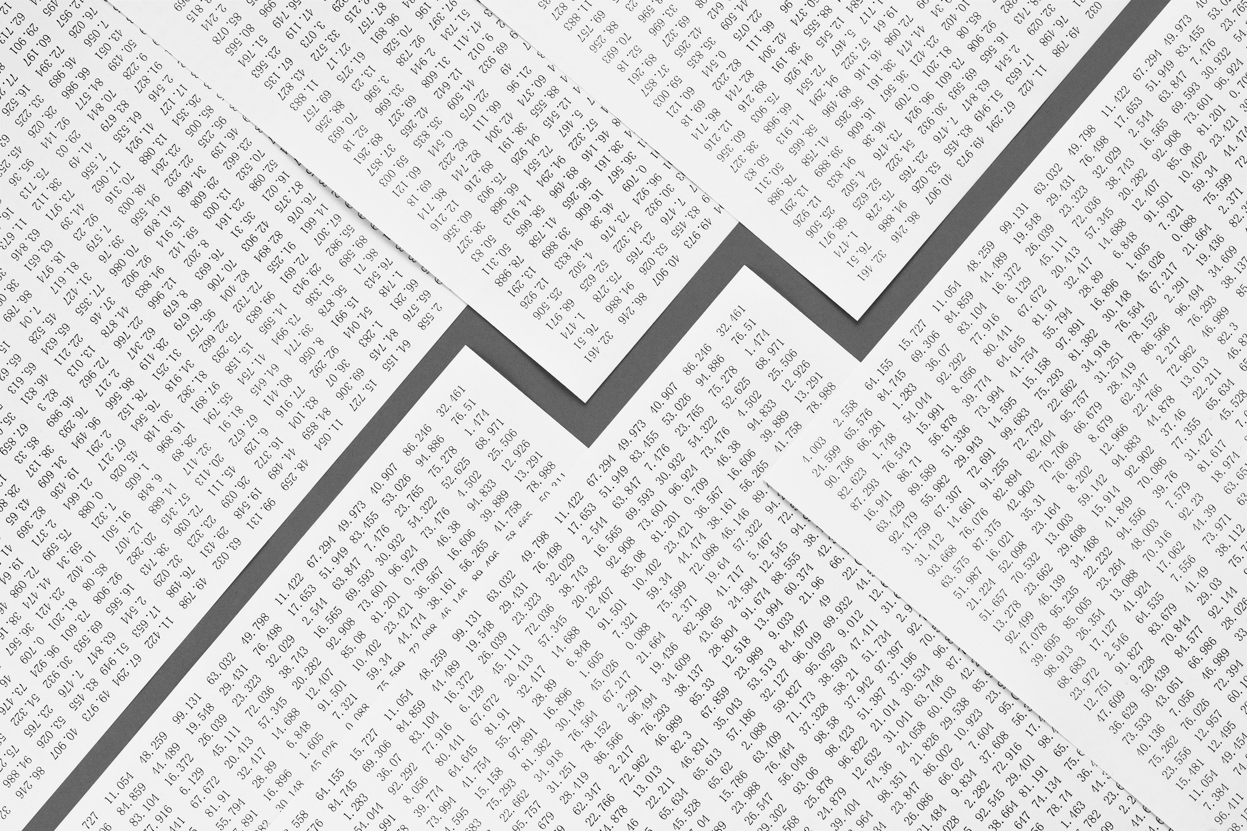
CONCLUSION
VARIABLES TOO HIGHLY CORRELATED
R-squared values were between 99-100% on each model
Predictor variables should be removed
Additional data required
challenges
Time
Knowledge of topic
Not enough data to predict CPI
Standardizing data
recommendations
Do more research on topic
Use a different model for prediction
Notes:
As most of the variables were already factors to measure CPI, the correlation results during EDA indicated that these variables may not be good predictors for modeling. Linear regression modeling confirmed these results when trying to use the variables to predict CPI. The current predictors should be removed. Additional data would be required to for prediction.
There were several challenges imposed with this project. Besides the limitation of time, understanding inflation without having a strong background and overall understanding of it was very challenging. The data selected raised questions for a couple reasons. The units for each variable were not uniform and required standardizing, which required research and more time to determine how to achieve. Another concern was not having specific monthly events for the [cause] variable and making the interpretation could have biased the data.
It is recommended to do more research on topic and determine if a different approach might be taken instead. Maybe focus on a different time period? Or continue to add data as inflation continues in 2022.
Linear Regression modeling was assumed the best choice for solving the business problem. The reason is it was selected was to be able to better understand and predict the relationships of independent and dependent features in a statistical sense. It was believed that the relationships of the features were linear, and that this type of model would best predict the business problem.
Another recommendation is to try a different model and determine if better results will occur. Polynomial regression might be an option. Unfortunately, time did not permit to explore other options with modeling.

Slide 23

ETHICS
ETHICAL ASSESSMENT
Secondary data collected, should not impose harm to participants
Project was conducted for informative purposes only
Notes:
There should not be a compromise with ethics for this project for a couple of reasons. One, the data used initially was collected from a secondary source. There is no bias with the data and it was not used for reasons that could impose any potential harm. Secondly, the words used to communicate and describe this information should not cause any widespread panic as there is no intention to create action or alarm. This project was conducted for informative purposes only.

Slide 24
REFERENCES
How to calculate consumer price index. Indeed Career Guide. (n.d.). Retrieved from https://www.indeed.com/career-advice/career-development/how-to-calculate-cpi
One Minute Economics (July 19, 2020) Consumer Price Inflation (Consumer Price Index/CPI) and Asset Price Inflation Compared in One Minute.
Retrieved from https://www.youtube.com/watch?v=TqXvpyNFW1U
Neufeld, D. (2021, June 11). Visualizing the history of U.S. inflation over 100 years. Advisor Channel. Retrieved from https://advisor.visualcapitalist.com/inflation-over-last-100-years/
Pathak, P. (2020, July 16). Implementing linear regression using Sklearn. Medium.
Retrieved from https://medium.com/analytics-vidhya/implementing-linear-regression-using-sklearn-76264a3c073c
Staff, U. S. I. C. (2022, April 12). Inflation calculator: Find US Dollar's value from 1913-2022. US Inflation Calculator |. Retrieved from https://www.usinflationcalculator.com/
Team, T. I. (2022, February 24). What causes inflation and who profits from it? Investopedia.
Retrieved from https://www.investopedia.com/ask/answers/111314/what-causes-inflation-and-does-anyone-gain-it.asp
U.S. Bureau of Labor Statistics. (2022, April 29). U.S. Bureau of Labor Statistics. Retrieved from https://www.bls.gov/
U.S. Bureau of Labor Statistics. (n.d.). CPI Home. U.S. Bureau of Labor Statistics. Retrieved from https://www.bls.gov/cpi/

